Slide 1
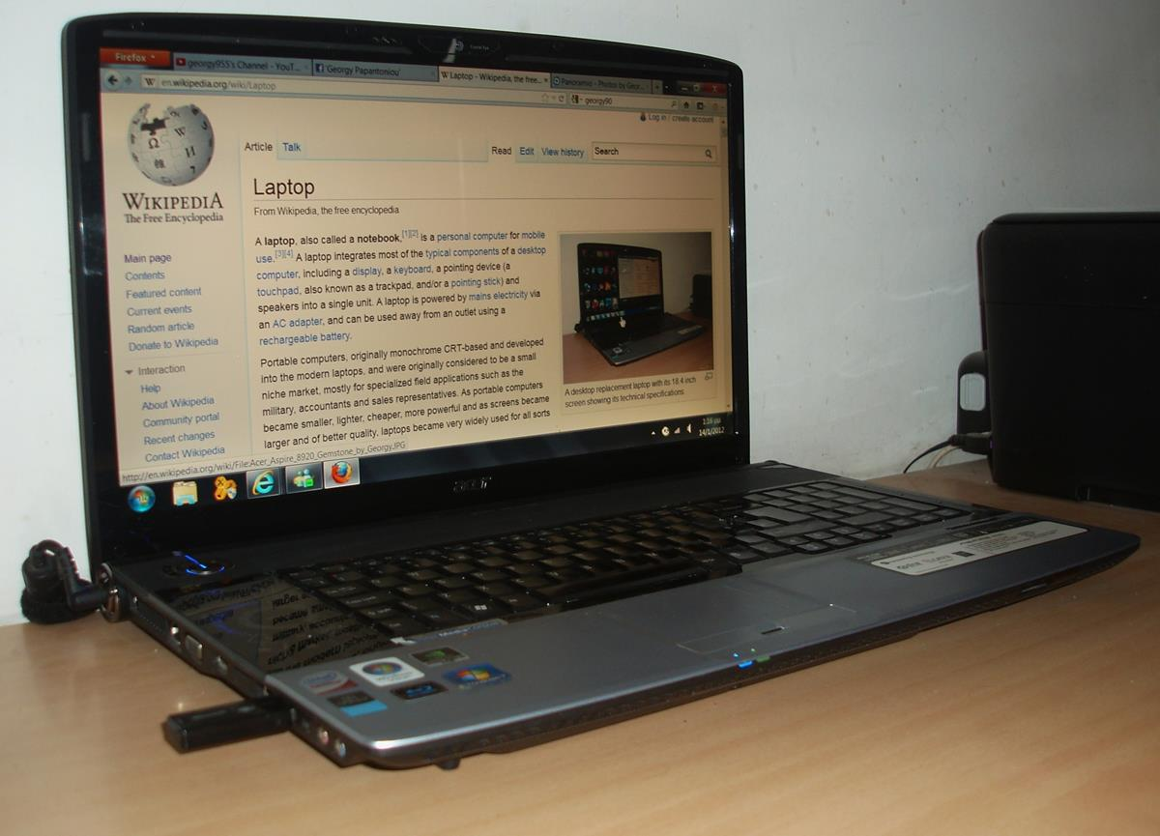
Digital Literacy
Computer Basics for success in business.

Slide 2

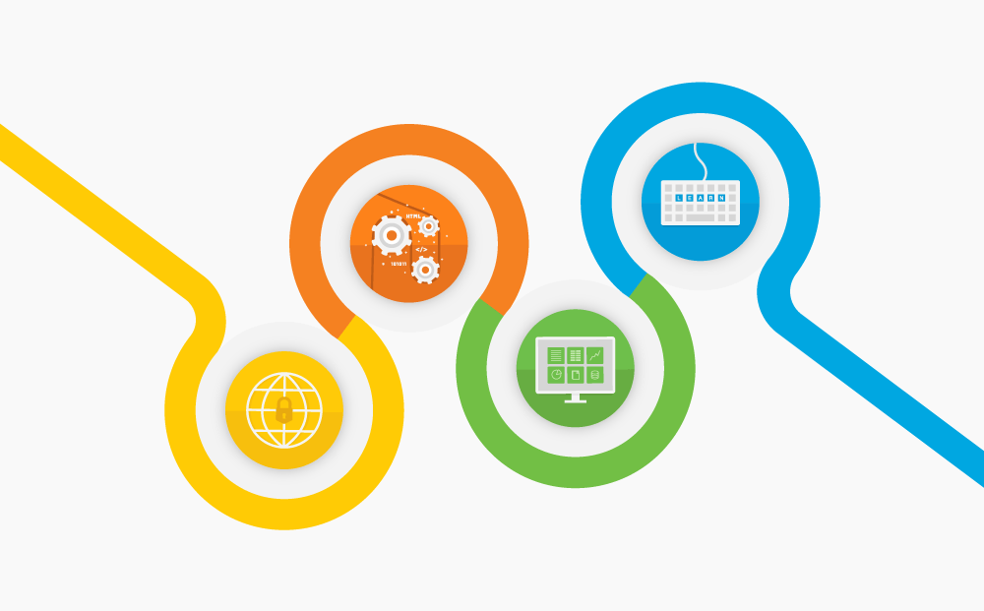

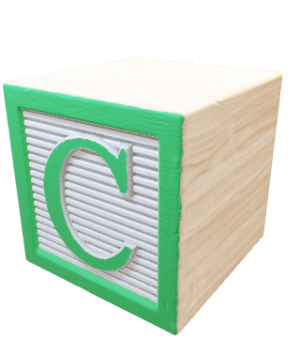

Digital Literacy
Find
Evaluate
Compose

Slide 3
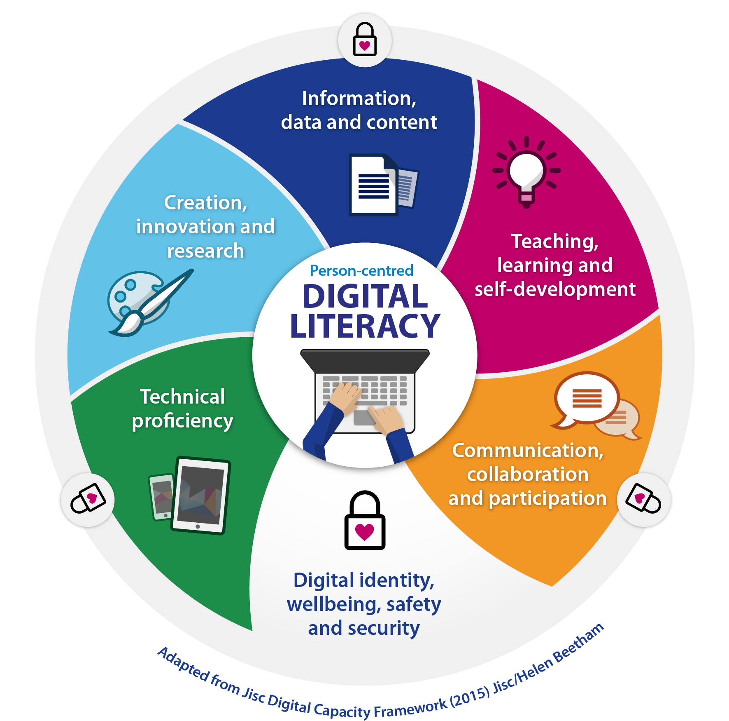
FEC
Notes:
Consider talking about:
By architecture
By size and form-factor

Slide 4
What is a computer?
A computer is a machine that can be instructed to carry out sequences of arithmetic or logical operations automatically via computer programming. Modern computers can follow generalized sets of operations, called programs. These programs enable computers to perform an extremely wide range of tasks.
-Wikipedia

Slide 5
What?
A computer is a machine that can store and manipulate information or data.
You, the user, input information using the keyboard and mouse. (Primarily)
The computer responds to your input by possibly manipulating data you’ve provided but always providing an output in the form of information on a screen. (Primarily)

Slide 6
Software and Hardware
A computer accomplishes its task using a combination of hardware and software. We do not need to know how the inside of a computer works in order to use the machine.
The two need each other to work.
Familiarity with both are needed in order to operate a PC.

Slide 7
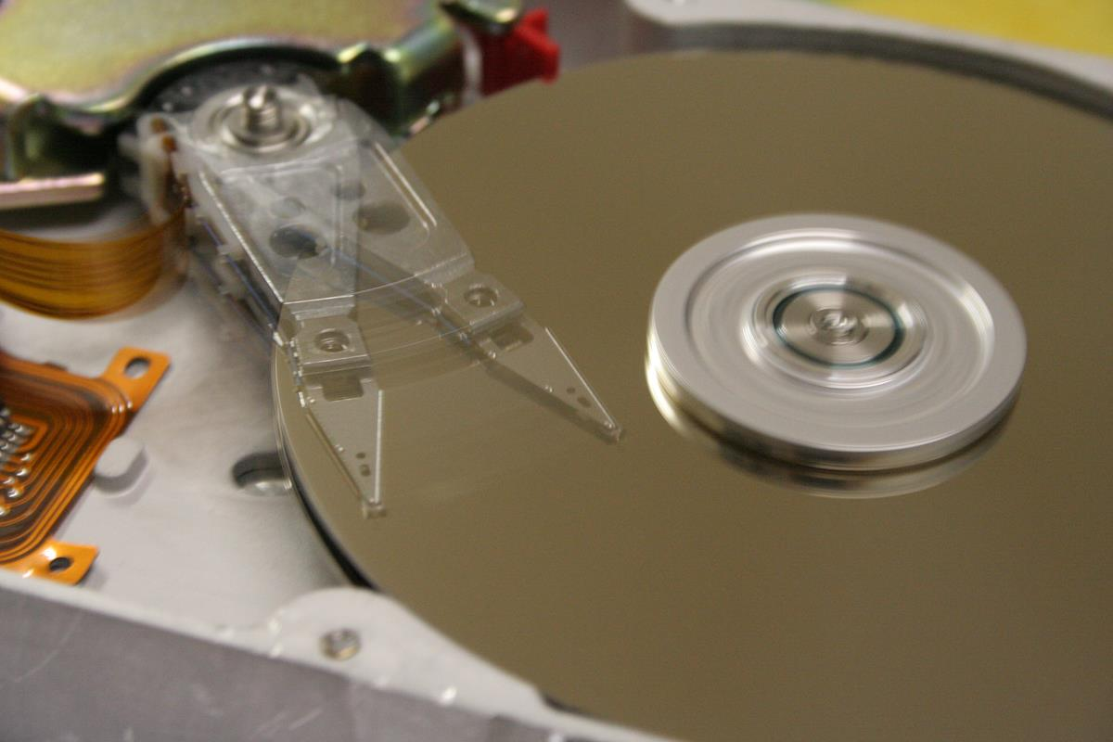
Hardware
Can be defined very easily as anything that can be touched!
(Whether it’s inside the machine or not)
Notes:
Consider talking about:
Other hardware topics
Input devices
Output devices
Control unit
Central processing unit (CPU)
Arithmetic logic unit (ALU)
Memory
Input/output (I/O)
Multitasking
Multiprocessing

Slide 8
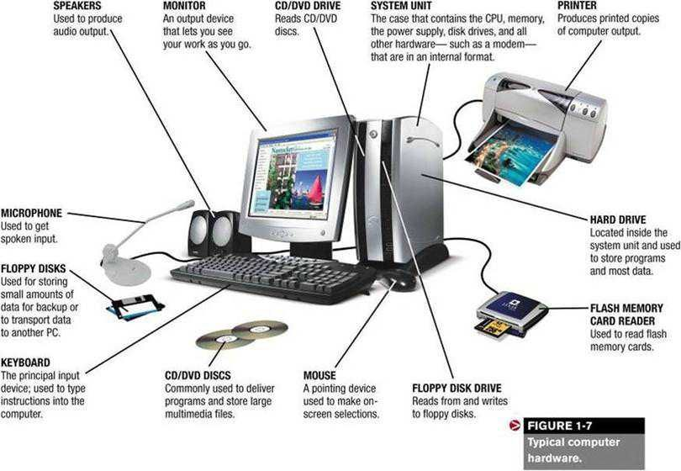
Hardware Examples

Slide 9
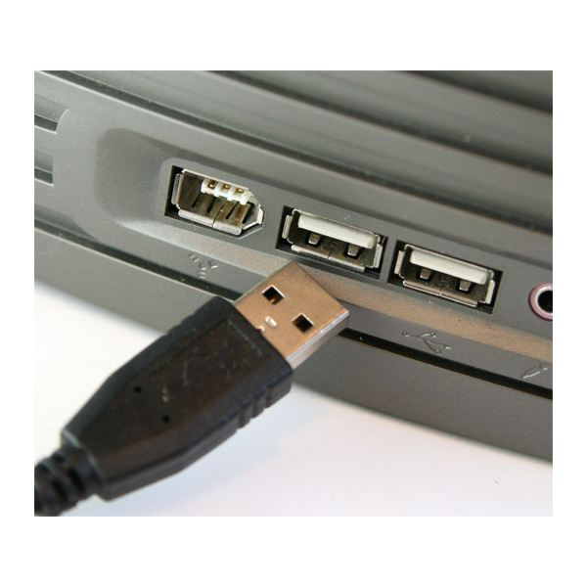
USB
USB ports can be used to connect a wide variety of hardware that interacts with your PC.
Common USB uses include mouse/keyboard and connecting external storage. →Flash/Thumb Drive or External Hard Drive

Slide 10
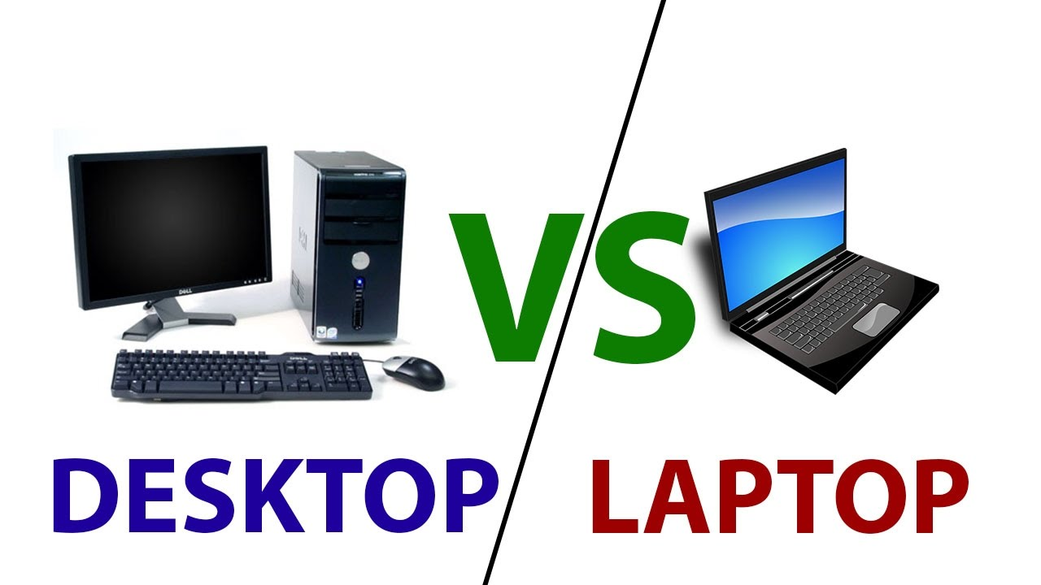
Laptop v. Desktop
Price
Portability
Upgrades/Special Hardware

Slide 11
Software
A collection of data and instructions that tell the computer how to work.
OS (Operating System)
Application software is software designed to perform a group of coordinated functions, tasks, or activities for the benefit of the user. Wikipedia
Notes:
Consider talking about:
Languages
Programs

Slide 12

Operating System
A piece of software that loads when the computer is turned on and manages all the computer's hardware and applications.
Windows 10
Used by the user to run applications and organize your data/information.

Slide 13

Every journey begins with one step…
In order to start a computer you need to power on any hardware.
-On a desktop this includes both the tower/system unit AND the monitor/screen.
-On a laptop you only need to power on the machine.

Slide 14
OS Navigation
Once the computer has booted up, you are presented with your desktop. (Provided you don’t need to log in first.)
The desktop contains your work area and the taskbar.

Slide 15
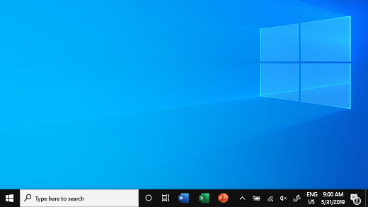
Taskbar
Work Area
Start/Windows Button:
The most important button on your desktop!!!
Single-Click here to do anything on your PC!
Quick Launch Icons/Open Programs
System Tray:
Contains the clock, VOLUME CONTROL, and NETWORK CONTROL

Slide 16
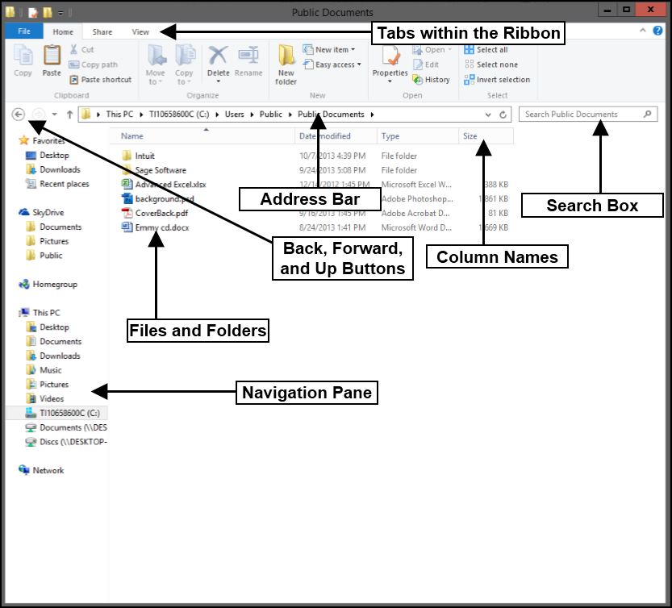
File Explorer
Allows us to view and manipulate folders, files, and applications. Four folders are provided for us called the Windows Libraries. Folders are used for ORGANIZATION ONLY.
Documents
Videos
Pictures
Music
(Downloads)?
Double-Click, Right-Click and Click and Drag can all be done on the desktop and between windows in File Explorer.

Slide 17
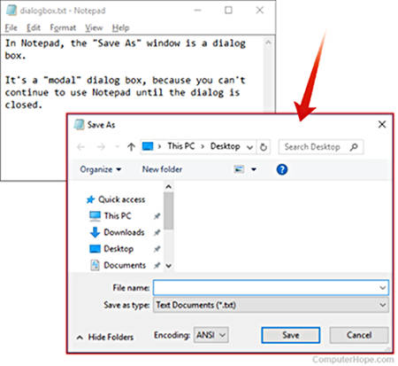
Dialogue Box
When you and the computer need to talk…
A window will prompt the user for some information.
Most commonly seen during Save and Open operations.

Slide 18

Microsoft Word
The first major app we will look at is Microsoft Word for word processing.

Slide 19


If Done
Open a web-browser and go to www.google.com
Type ‘google docs’ in the search bar (minus the ‘ ’)
You should see the result at or near the top that says:
Google Docs: Free Online Documents for Personal Use
Click the link.
Read about google docs. Write in Word what some of the features of docs are as well as any differences you noticed while reading. Save into documents as “docs_in_word” (minus the “ “)

